Slide 1


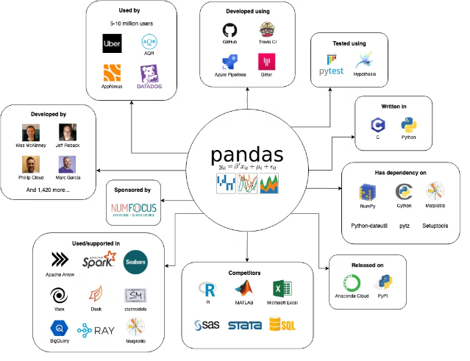


Introduction to Pandas
Pandas is a powerful Python library for data analysis and manipulation. It provides high-performance data structures and data analysis tools, making it a cornerstone for data science in Python.
by Manjeet Singh

Slide 2

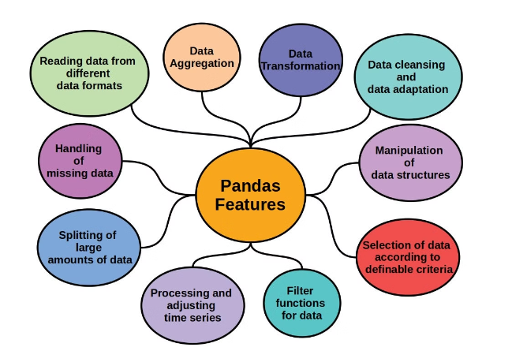
Key Features of Pandas
1
Data Structures
Pandas introduces two primary data structures: Series (one-dimensional) and DataFrames (two-dimensional).
2
Data Alignment
Pandas automatically aligns data based on labels, simplifying complex operations.
3
Data Indexing
Data can be accessed and manipulated using labels, making it intuitive to work with.
4
Data Cleaning
Pandas provides tools for handling missing values, duplicates, and data inconsistencies.

Slide 3
Data Structures in Pandas
Series
DataFrames
Panel
One-dimensional labeled array, similar to a column in a spreadsheet.
Two-dimensional labeled data structure, representing a table with rows and columns.
Three-dimensional data structure, representing a collection of DataFrames.

Slide 4





Data Manipulation with Pandas
Selection
Selecting specific data points based on labels or conditions.
Filtering
Filtering data based on specific criteria, similar to SQL WHERE clause.
Transformation
Modifying data through functions, calculations, and aggregations.
Merging
Combining data from multiple sources based on shared keys.
Reshaping
Altering the structure of data, like pivoting or stacking.

Slide 5


Unleashing the Power of Data Analysis with Pandas
Descriptive Statistics
Leverage Pandas to calculate insightful metrics like mean, median, standard deviation, and more, providing a comprehensive overview of your data.
Data Aggregation
Group your data by relevant criteria and apply powerful aggregation functions to uncover hidden patterns and trends within each segment.
Correlation Analysis
Measure the strength and direction of relationships between variables, enabling you to identify important interdependencies in your data.
Time Series Analysis
Analyze data that varies over time, such as stock prices or weather patterns, to uncover insights, identify trends, and make informed decisions.

Slide 6






Pandas in Data Science
Data Loading & Cleaning
Pandas simplifies the process of loading data from various sources and cleaning it for analysis.
Feature Engineering
Pandas allows for creating new features from existing data, improving model performance.
Machine Learning
Pandas DataFrames are readily compatible with popular machine learning libraries.
Data Visualization
Pandas integrates seamlessly with visualization libraries like Matplotlib and Seaborn.

Slide 7

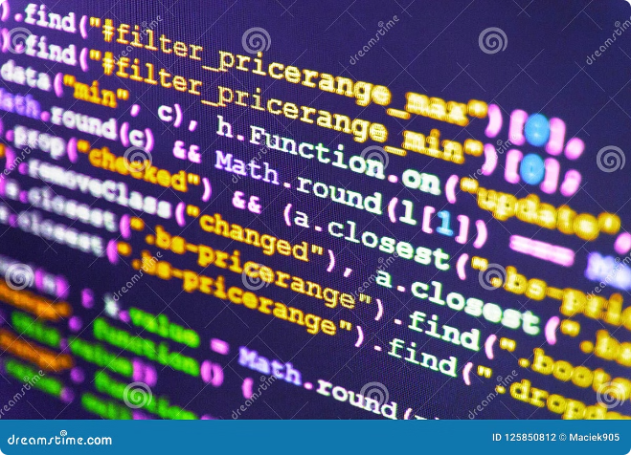
Pandas Performance and Optimization
1
Vectorized Operations
Pandas leverages NumPy's efficient array operations for high-performance data manipulation.
2
Data Type Optimization
Choosing the appropriate data types for columns can significantly improve performance.
3
Memory Management
Pandas uses efficient memory management techniques to handle large datasets.
4
Parallel Processing
Pandas can leverage multiple processor cores for faster execution of operations.

Slide 8


Pandas Ecosystem and Community
Scikit-learn
A popular machine learning library that integrates seamlessly with Pandas.
Matplotlib & Seaborn
Visualization libraries that work well with Pandas for creating informative plots.
Statsmodels
A library for statistical modeling and hypothesis testing, often used in conjunction with Pandas.
Active Community
Pandas has a vibrant community of users and developers, providing support and resources.

